Slide 1
5S for the Office
Notes:
NOTE: The 5S training module is intended for use at kaizen event training. The training is a “Learn-Do” approach in which there are designated points in the training course for the participants/kaizen teams to stop and apply their learning to their kaizen project/event. The training material is recommended for a 5 day event, but is scalable for events of any length.

Slide 2

Other Modules In This Series:
5S
Standard Work
Total Productive Maintenance (TPM)
Administrative Lean
Cell Design/ Production Preparation Process (3P)
Kaizen
Kanban
Problem Solving
Poka Yoke Quality Systems
Transaction Process Improvement (TPI)
Cause & Effect Diagram with the Additions of Cards (CEDAC)
Single Minute Exchange of Dies (SMED)
Value Stream Mapping (VSMi®)
Visual Management
Managing Daily Process Excellence
For More Information Please Contact:
Mark DeLuzio, President and CEO
+1.860.234.0915
mark.deluzio@leanhorizons.com
Strategically Creating Value Through the Elimination of Waste

Slide 3
This document contains confidential
and proprietary information owned
by Lean Horizons Consulting, LLC.
Any disclosure, use, copying or
distribution of this information without the express written consent of Lean Horizons Consulting is strictly prohibited.

Slide 4
Ground Rules for Event
Safety first (use personal protective equipment)
Active participation by all
Start and end on time
All electronic gadgets (phones, pagers, etc) turned to “off” or “silent”
Computers to be used only when instructed
Keep an open mind to change
Don’t let “perfect” get in the way of “better”
Notes:
DO: Perform Group Introductions. Pick an ice-breaker or exercise to warm the team up to the event. (Icebreaker Example: Everyone uses their name tent and writes a “Personal License Plate” in which they have 2 minutes to creatively use a total of 7 letters or numbers to tell us something about themselves. Examples “LV2SAIL” OR “DADOV5”
DO: Review Event Ground Rules.
ASK: “Does anyone have any rules they would like to see added?”
ASK: “Does everyone agree to these?”

Slide 5
Goal of 5S Module
Define 5S and apply to your office, information and transactional processes to achieve target goals for your business
5S
Definition
5S
Process
5S
Review
Notes:
DO: Introduce the notion of 5S and the goal of this event.
At this time it is appropriate for the Process Owner or the Kaizen Team Leader to review the kaizen charter and objectives of the event.

Slide 6
5S
5S Definition
5S Process
5S Review
Objectives:
Define goal of 5S
Define 5S concepts
Identify benefits of 5S
Define 5S process steps
Discuss impact of 5S in your office
Define 5S implementation roadmap
Review 5S event charter
Notes:
DO: Review section objectives on slide.

Slide 7
Goal of 5S
5S Definition
Benefits of 5S Culture
The goal of 5S is to create
workplace organization,
improve productivity,
enable visual management, and lay the foundation for all other lean tools used for continuous improvement.
Productivity
  Eliminate wasted time looking for information and office supplies. Reduce processing time and office equipment downtime. Prioritize tasks more easily.
Quality
  Eliminate the possibility of using obsolete or incorrect information.
Safety
  Reduce the number of lost time accidents, workman’s compensation claims and
  OSHA recordables.
Notes:
ASK: Has anyone ever wasted time looking for a phone number? A pen? An email? Wouldn’t it be great to have everything you need exactly when you need it – ALL THE TIME?
ASK: Has anyone ever used the wrong information? (may ask them to elaborate)
ASK: “What safety hazards have you seen in the office area due to clutter, disorganization or lack of office equipment maintenance?”
NOTE: There have been numerous lost time accidents seen in the workplace due to unsafe chairs, blocked walk-ways, faulty or damaged electrical wiring, over-crowded conditions, etc. One office accident resulted in permanent disability when an associate simply tripped, but when he reached for the cubicle wall it fell on his head, causing very serious concussion. It is a bigger issue than is typically considered. Another huge consideration is workplace ergonomics – carpal tunnel injuries due to workplace design.

Slide 8
What is 5S?
5S Definition
Is about sustained workplace organization and discipline |  | Is not about “spring cleaning”
Is a tool that benefits the entire organization |  | Is not a “shop-floor only” tool
Is a continuous process and an on-going management tool |  | Is not a one-time event
Is for everyone |  | Is not “someone else’s” responsibility
Is a basic foundation for all other improvement |  | Is not optional

Slide 9
5S – Original Japanese Terminology
5S Definition
5S Descriptions
1S
Seiri
(整理)
Tidiness, organization
Refers to the practice of sorting through everything in the work area and keeping only essential items. Everything else is stored or discarded. This leads to fewer hazards and less clutter to interfere with productive work.
2S
Seiton
(整頓)
Orderliness
Focuses on need for an orderly workplace. Information, equipment, and materials must be systematically arranged for the easiest and most efficient access. There must be a place for everything and everything must be in its place.
Notes:
Add phonetic spelling for each Japanese word
Seiri = Sear-e
Seiton = Say-ton

Slide 10
5S – Original Japanese Terminology, Continued
5S Definition
5S Descriptions
3S
Seiso
(清掃)
Systemized Cleanliness
Indicates the need to keep the workplace clean as well as neat. Cleaning in Japanese companies is a daily activity. At the end of each shift the work area is cleaned up and everything restored to its place.
4S
Seiketsu
(清潔)
Standards
Allows for control and consistency. Basic housekeeping standards apply everywhere in the facility. Everyone knows exactly what his or her responsibilities are. Housekeeping duties are part of regular work routines.
5S
Shitsuke
(躾)
Sustaining discipline
Refers to maintaining standards and keeping the facility in safe and efficient order day after day, year after year.
Notes:
Add phonetic spelling for each Japanese word
Seiso = Say-zoo
Seiketsu = Say-kat-zoo
Shitsuke = Sheet-Soo-key

Slide 11
5S – English Translations
5S Definition
5S | English | Description
1S | Sort | Eliminate what is unnecessary and identify frequency of use for necessary
2S | Straighten | Create a place for everything and put everything in its place
3S | Scrub | Thoroughly clean the area and identify the sources of uncleanliness
4S | Stabilize | Execute process to maintain and improve the first three S’s
5S | Sustain | Develop a sustained, disciplined 5S culture in the workplace
Notes:
SAY: You will see variations in the English translations for each “S”, but the meaning is the same.
NOTE: per WIKIPEDIA: Alternative acronyms have been introduced, such as CANDO (Cleanup, Arranging, Neatness, Discipline, and Ongoing improvement), and the 5C’s:
Clear out and Classify. Clearing items no longer required. Tagging items that may be required and storing away from workplace
Configure. A specific place for specific items. “ A place for everything & everything in its place”
Clean and check. Identify cleaning zones, establish cleaning routines
Conformity. Consolidate the previous 3C’s by standardizing the new process and use of ‘Visual Management’
Custom and practice. Monitor process adherence. Continually validate process. Make further improvements using the PDCA cycle, otherwise known as the Deming cycle

Slide 12
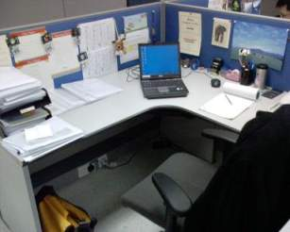
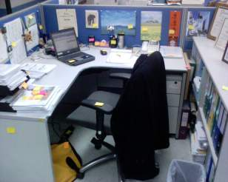
Step 1 - Sort
5S Definition
Before
After – Put color tags on object in workstation

Slide 13
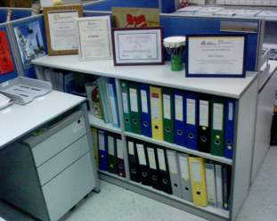
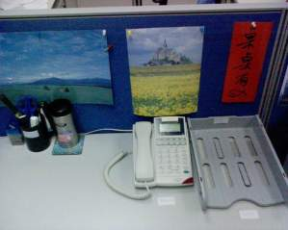
Step 2 – Set in Order
5S Definition
Label folders, put in sequence and guided by dotted line
Install tray and put labels for objects

Slide 14
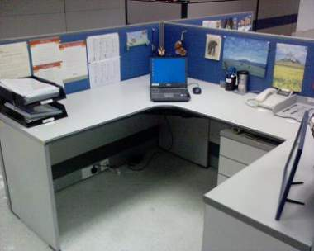
Step 3 - Shine
5S Definition
Clean the table & equipment and tie up cables

Slide 15
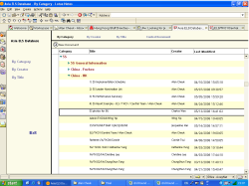
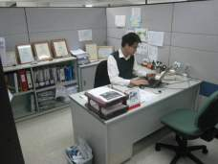
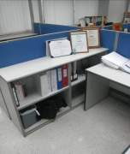
Step 4 - Standardize
5S Definition
Share Best Practice in Lotus Notes 5S Database to Standardize 5S between Team Members
Standardize on: Dotted line on box files, Labeling on shelf, Display of certificate

Slide 16
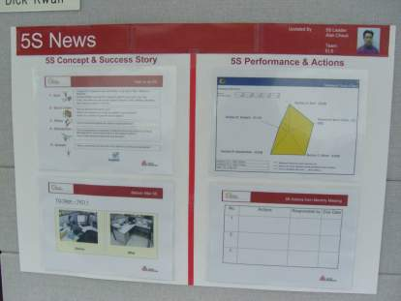
Step 5 - Sustain
5S Definition
5S Notice Board
Construct 5S Notice Board to display:
5S Concept – Reinforce the “Know How” of 5S
Success Story - Prove 5S is achievable by example
5S Performance- Provide feedback on monthly performance
5S Action- Provide direction on continuous improvement

Slide 17
Exercise: 5S Discussion
5S Definition
Objective
Discuss the impact of 5S in your work area.
Instructions
Time to Complete
In small groups, discuss the issues you have
seen in your work environment as a result of a
lack of 5S
Answer “what wastes were caused?”
Discuss personal advantages to working in a 5S culture
Table answers on a chart paper
10 minutes
Deliverable
One person from each
group reports results of
discussion to rest
of class
Notes:
NOTE: Facilitator needs to ensure that teams capture the "What's in it for me?" Will help internalize the objectives and benefits for each member. MAY want to revisit these lists at conclusion of event… were expectations met or exceeded? to reinforce value of module.

Slide 18
5S Implementation Roadmap
5S Definition
5S Event
PROCESS STEP 1
PROCESS STEP 2
PROCESS STEP 3
PROCESS STEP 4
PROCESS STEP 5
Complete
5S Event
Pre-Work
Capture “Before Event” Data
Execute
5S Process
Document
Results
Achieve
5S Culture
Review data retention requirements
Identify policies for handling confidential or sensitive information
Complete event charter & preparation
Review pre-work and event charter with team
Photograph areas
Measure virtual and physical space
Identify waste
Implement 1S
Implement 2S
Implement 3S
Develop tools
to standardize and maintain results
Photograph areas
Measure virtual
& physical space
Quantify waste reduction
Implement 4S tools
Sustain results
Develop habits
Improve processes
Implement for entire business
5S has been quoted as the most important of all lean tools
Notes:
SAY: The 5S Process is VERY Prescriptive! It is important to implement them in the order defined. 5S Culture is a mindset and habit developed through DISCIPLINE, perseverance and commitment and includes continuous improvement of the process itself. 5S requires a MINIMUM of six months, even years achieve.

Slide 19
Exercise: 5S Charter Review
5S Definition
Objective
Review the 5S Charter for the event against charter criteria
Instructions
Time to Complete
In each team, review the event charter and answer the following questions:
What is the business need for this event?
Who is the owner?
What are the clear procedural boundaries?
What is the scope for this event? (Computer files included? Entire office? Adjacent areas?)
What are the goals for this event?
30 minutes
Deliverable
Make any modifications to charter as necessary.
Notes:
NOTE: Office owner must determine if there are any "Private“/”Sensitive” data items which are off-limits; specify how much computer 5S to include…careful not to do TOO much and become solitary effort (may need to establish standard, and apply to xx% of hard drive, then place remainder on newspaper). Important for all team members to be engaged at all times.

Slide 20
5S
5S Definition
5S Process
5S Review
Objectives:
Identify 5S opportunities in the office
Review components of each 5S step
Apply each step to your business
Notes:
DO: Review section objectives on slide.

Slide 21
5S Opportunities in the Office
5S Process
5S for the Office CHECKLIST
Books
Bulletin Boards
Business Forms
Business Cards
Cabinets
Catalogs
Computer Equipment
Computer Files
Conference Rooms
Correspondence
Credenzas
Desks
Drawers
Electrical Connections
Email
Files
Magazines
Mail Rooms
Office Equipment
Paper
Personal Items
Printers/Fax Machines
Records
Samples
Shelves
Supplies
Tables
Telephones
Voice Mail
White Boards
Notes:
DO: Have participants pull this CHECKLIST out for use during event. This is a handy reference to make sure you don’t miss any “hidden” items.
ASK: the participants if they can think of other areas which should be reviewed (write them down).

Slide 22
5S Process Steps
5S Process
1S - Sort
    2S - Straighten
3S - Scrub
4S - Stabilize
5S - Sustain

Slide 23
5S Process Steps
5S Process
1S - Sort
    2S - Straighten
3S - Scrub
4S - Stabilize
5S - Sustain

Slide 24
1S Defined
5S Process
English: SORT
Japanese: SEIRI
Objective
of 1S
SORT
Simplify the area. Clearly distinguish between what is necessary and unnecessary and dispose of the unnecessary
SEIRI
Tidiness, organization. Refers to the practice of sorting through all the tools, materials, etc. in the work area and keeping only essential items. Everything else is stored or discarded. This leads to fewer hazards and less clutter to interfere with productive work.
Reveal the process by eliminating what is unnecessary from the workplace
1S reveals the true process

Slide 25

1S Sort Strategy
Throw away anything you know you can
Identify truly needed items by asking:
  What is it for?
  Why do I have it?
  How often do I use it?
  Does someone else have it?

Slide 26
1S Sort Strategy, continued
5S Process
Frequency of Use Disposition
Unnecessary
Cannot be used
Discard or delete
Unlikely to be Used
Discard, delete or donate
Rarely Used
Store remotely or electronically
Occasionally Used
Store nearby for easy access
Frequently Used
Store close at hand for ready-access
Notes:
SAY: First step is to literally SORT everything included in your scope of this event. Throw away anything you know you can. This includes your computer files as well. Remember that purpose of 1S is to SIMPLIFY and reveal the actual business process. Hold off on literal “storing” of items that you keep in your office until implementation of 2S when you decide on organizational techniques.
NOTE: If needed, common definitions of “frequencies”: Rarely Used = once or twice per year; Occasionally used = monthly or weekly; Frequently = Daily or Hourly or “Constantly”.

Slide 27
1S Sort Strategy, continued
5S Process
Don’t forget your computer files and email!
Minimize personal items
Only leave the bare essentials
Tape binders and books closed and mark with “date last used” to identify future items to discard or store remotely
Consider using a common library for books or reference materials (establish clear owner and process)
Notes:
SAY: Avoid personal collections. If you have more personal items than work-related items, then you have too much! Remember to keep your work area professional and don’t let personal items clutter your space.
SAY: If you have books or binders that you aren’t comfortable discarding today, then take a small piece of tape to close the book with. Mark today’s date on it with “date last used.” When you get to the fourth S, you can implement a process to check these items once a month or so, and discard when you realize that you really don’t need it. Also, if you have popular books you want to keep to share with others in the company, consider establishing a central/common “library” for “public” use. HOWEVER, make sure you don’t just create another dumping ground. Should you decide to go this route, make sure everyone is on board and there is a clear owner for the area, as well as a visual process for using the library.

Slide 28
1S Sort Strategy, continued
5S Process
“When in doubt, throw it out!”
Establish temporary staging/review area for “red tag” items
  Use for re-usable office equipment or furniture
  Use to consolidate items for recycling
  Identify who must review and disposition
  Ensure all items dispositioned before end of this event
  DO NOT MAKE A NEW MESS!
Notes:
ASK: the group to identify where to place items that may be re-used or needed by someone else (I.e. a “red-tag” area). Make SURE that this area is cleared out before the event is complete! These areas tend to get forgotten or just become a way of storing junk somewhere else!
Have Multiple Teams use ONE area for “review” and encourage them to plan a time for everyone to get together at specific team during event week to decide what to do with what is in this area (ie, OK to trash, Sell/Auction to employees for personal use, Store in approved area, deliver to Mr. XYZ or MRS. PDQ, Donate to School, Raffle off for charity, Deliver to Recycling Facility, etc.)

Slide 29
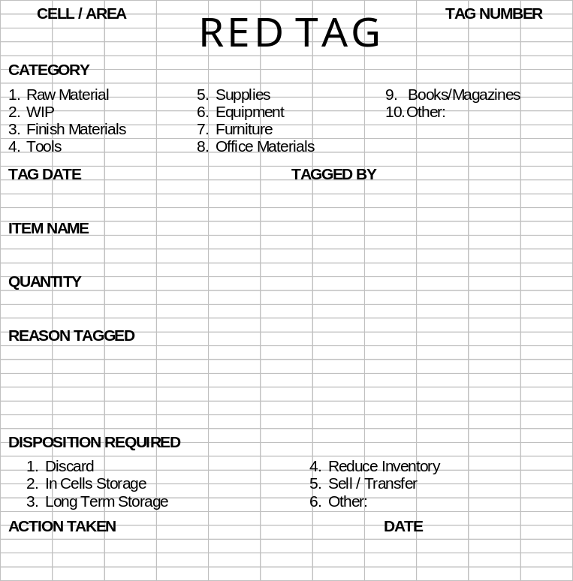
Red-Tagging Process
5S Process
Red Tag Template
Tracking process to provide visual identification and formal disposition
Utilize for discarded items that may be needed or stored in another area (such as re-usable office furniture)
Should be full size
(8.5” x 11”)
Bright red to promote visibility
Should have pre-printed sequential tag numbers
Perforated lower section to record location of tag
Disposition required with clear ownership defined

Slide 30
Red-Tagging Procedures
5S Process
Step 1
Step 2
Step 3
Step 4
Step 5
Select members from various teams
Select a high level manager to participate as a team member
Identify Red Tag targets
Determine location for all red tag items during event
Determine what criteria will used to distinguish a needed item from an unneeded item
Example: Save only the items needed to conduct business in the area
Explain red tag criteria to teams
Ensure a good cross-section of people tagging items to prevent “I might need that”
Red tag work area as rapidly as possible
Evaluate red tag items
Dispose of truly unnecessary items
Retain red tagged material if there is proper justification
Discard any material which has been red tagged after a pre-determined time
Complete all red tag information. returned to the red tag coordinator

Slide 31
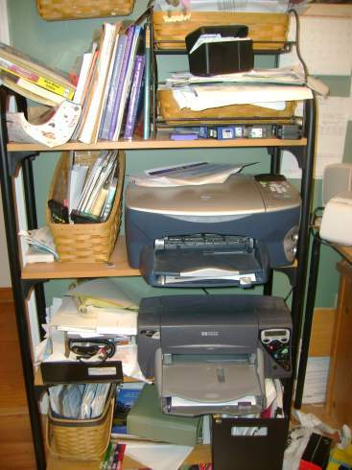
1S NON-Example
Why are there TWO printers?
Why are there multiple used printer cartridges scattered about?
What, exactly, is on this shelf?

Slide 32
Exercise: 1S
5S Process
Objective
Analyze Case Study
Instructions
Time to Complete
In each team, carefully review the photos from the case study
Answer “how would you implement “1S” in this office, based on what you see (or don’t see)?”
Include questions you would need to ask the owner
Record notes on chart paper for review with class
15 minutes
Deliverable
1S Strategy – one person to report out to rest of class
Notes:
DO: Hand out color copies of the case study photos, one set per team. Ask them to save the photos for other exercises in this module.
NOTE: Potential Answers/Strategy:
Recommend first step to literally remove everything from the area and then sort into the categories of how often the items are used. (Never, rarely, weekly, daily, hourly, etc.). Throw away anything that is never used and consider “remote storage” for rarely or infrequently used items.
For consideration: It looks like more than half the desktop space is used for personal photos (?). Recommend that these be consolidated into a collage or perhaps only use one or two photos? Could purchase an inexpensive collage-type photo frame for most of the photos and hang on the wall BEHIND the desk – this would free up ~50% of desktop space which should be used for FREQUENTLY used items!
Also, examine the amount of office supplies in top drawer – looks like large box of pencils – this is a year’s worth or more of inventory? Recommend a central supply storage for office supplies and only keep minimal amount in “handy” locations where VERY frequently used items should go… or, if there is room, there could be a small shelf or storage area behind the desk area or even may have room in a BOTTOM drawer for the excess supplies.
There are boxes on the floor, boxes in the cabinet and items in the corner of the room? Need to carefully examine these items to determine where and if they belong. Obviously, the box on the floor does not…
Use a virus scan software or pc management tool (if available) to quickly scan computer for files and programs not used recently. Use this data to delete files and remove unused programs. Don’t forget to record the amount of disc space used before making any changes!

Slide 33
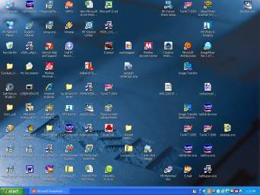

1S Example
5S Process
Deleted unused icons
Removed unused programs
Deleted old files or archived onto CD’s
Notes:
NOTE: This is an example of a computer desktop before and after. Remind participants that 5S covers electronic/virtual media as well as the tangible items in the office.

Slide 34
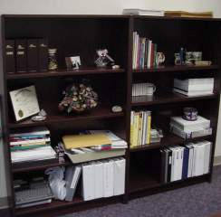
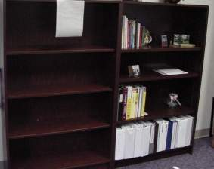
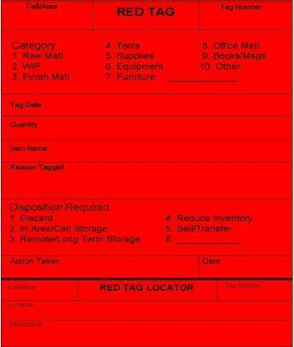
1S Example
5S Process
Before
Removed unnecessary items and freed up one entire bookcase (red-tagged for disposition)
Moved necessary items to filing system
After
Notes:
SAY: By eliminating unnecessary items, this office owner gained valuable “real estate” and donated this shelf to a co-worker who was about to order a new one!
ASK: Which picture do you find more visually appealing?

Slide 35
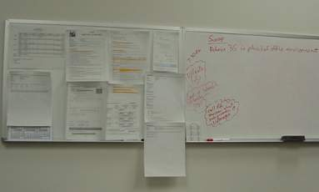
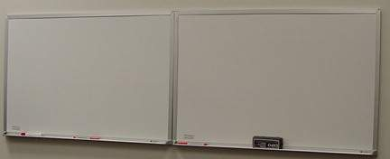
1S Example
5S Process
Before
White board not being used for its purpose
Old information not erased
After
Notes:
ASK: How often do you see this? Make sure you are using office “tools” for the purpose intended.

Slide 36
Exercise: 1S
5S Process
Objective
Complete 1S for the business event
Instructions
Time to Complete
Capture “before event” data (before pictures, hard drive megabytes in use, number of emails read/unread, etc.)
Determine how to handle “sensitive” information
Discuss approach to completing 1S
Assign individual tasks
Determine time to accomplish 1S and review
results
Provided by instructor
Deliverable
Completed 1S
Notes:
DO: Work with teams to agree on time to complete 1S. Instruct all teams to return to the training room at the specified time, regardless of whether or not they are actually done. It is important that no one hold up the entire group by causing the waste of WAITING! You can go back and complete the first “S” before you continue with the second “S”, if necessary.

Slide 37
5S Process Steps
5S Process
1S - Sort
    2S - Straighten
3S - Scrub
4S - Stabilize
5S - Sustain

Slide 38
2S Defined
5S Process
English: STRAIGHTEN
Japanese: STRAIGHTEN
Objective
of 2S
STRAIGHTEN
Organize the necessary items so that they can be used and returned easily
SEITON
Orderliness. Focuses on the need for an orderly workplace. Tools, equipment, and materials must be systematically arranged for the easiest and most efficient access. There must be a place for everything and everything must be in its place.
Place all items and information in the best location and visually organize
2S promotes visual management

Slide 39
2S Strategy
5S Process
Determine best layout and work space design so that everything is easy to use and understand
Organize using storage methods that promote visual management (use frequency identified during 1S process)
  Folder method (preferred paper method)
    Folder capacity of <70 sheets is best (100 sheets max)
    Assign each folder its own storage period
  Binder method
  Electronic (with appropriate back-up)

Slide 40
2S Strategy, continued
5S Process
Standardize your naming conventions
  File/Folder/Binder name is its “address”
  Select best nomenclature for each type (region, subject, code, date, etc.)
  Clearly label everything
Implement “Work in Process” drawer and/or folder to segregate data and projects in use
Place frequently used items in immediate work area, NOT in a drawer or cabinet

Slide 41
2S Strategy, continued
5S Process
Design your standard desktop
  Use unobtrusive labeling, such as small clear labels
  Create a template or outline for office supplies
  Avoid use of cups or boxes for storage
  Eliminate unnecessary flat surfaces
Visually indicate locations so items can be returned and missing items are easily identified
Post photos or signs to clearly explain information, equipment, and other items so anyone can understand

Slide 42
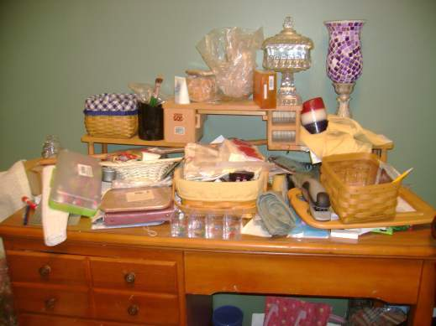
2S NON-Example
5S Process
Where is the stapler?
Is it here or is it missing?
How would I know?
Notes:
ASK: What would driving be like without signs, traffic signals and road markings? Visual management gives quick and easy directions to avoid a wreck (like this desk!)!
NOTE: In case anyone really cares, the stapler is on the right, directly below the red, white and blue candle (it is tan colored with brown accents)

Slide 43
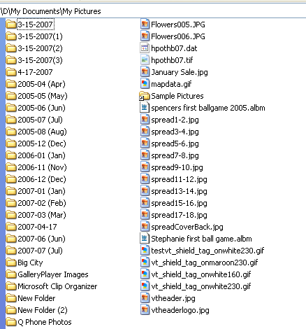
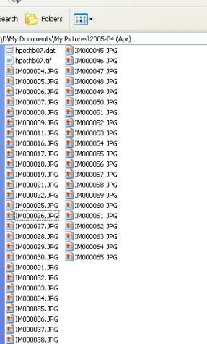
2S NON-Example
5S Process
Where is the picture I need?
Folders and contents do not have meaningful names
Notes:
ASK: Have you ever had problems finding a file on your hard drive? Or on a shared drive (even worse!). Taking the time to properly name files up-front will save you immeasurable time in the future.

Slide 44
Exercise: 2S
5S Process
Objective
Analyze Case Study
Instructions
Time to Complete
In each team, carefully review the photos from the case study
Answer “how would you implement “2S” in this office?”
Include questions you would need to ask the owner
Record notes on chart paper for review with class
15 minutes
Deliverable
2S Strategy – one person to report out to rest of class
Notes:
DO: Give participants “creative license.” They can start making assumptions in this exercise, if it helps. The point is to apply the process within the classroom to ensure that the learners truly understand.
NOTE: Potential Answers/Strategy:
Recommend creating an outline/template with clear labels, on the desk to identify where all FREQUENTLY used items should belong. Consider whether the owner is right-handed or left, and how to orient these items for ease of retrieval, use and return. Do NOT put ANYTHING in a DRAWER that is used throughout the day! It is wasteful opening and closing a drawer when unnecessary! Use the clear labels for all items on desk and for drawers/shelves, etc. to identify items at that location.
Create a meaningful labeling/naming convention for the paper files and make sure that any computer files are named to correspond appropriately.
Don’t forget to organize all the computer data into folders, as well.
Take a close look at the many electrical cords. These will need to be checked to ensure there is no damage or fraying. Consider using a simple mounting bracket for the power strip and mount on inside or bottom of desk – this will allow more floor space for feet and eliminate potential hazard. The cords should be bundled together neatly and ties used to hold them together.
Also, might want to mount a simple hook on the wall to place jackets, PC bag (in corner of room), etc.
Be sure and create a “WIP” location, either using table top files/folders or an organized drawer.
Anything located INSIDE a drawer should also be labeled and organized using appropriate dividers (you can buy a plastic drawer organizer for just a few dollars to help segregate and identify items).

Slide 45
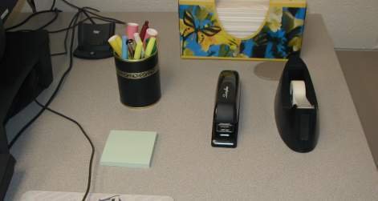
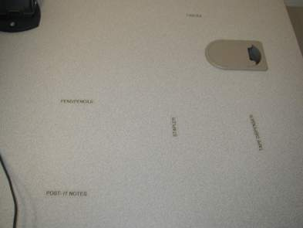
2S Example
5S Process
Labeled desk top creates visual management for office supplies
Anyone can quickly see when something is missing and where it belongs
Notes:
SAY: Here is a simple use of visual management similar to the template or outlining technique. The clear labels are unobtrusive, yet effective. You can quickly see what is missing or where to replace an item in use.

Slide 46
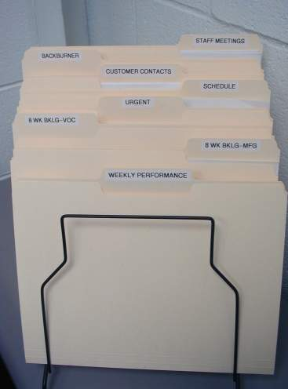
2S Example
5S Process
WIP (work in process) folders keep frequently used information readily available
A WIP drawer may be used to stow away larger items in use, such as books, binders, CD’s
Standard color code system would improve visual management
Notes:
SAY: Create a work-in-process drawer or folder (or set of folders, as seen here) to keep items that you are currently using. This allows quick, easy access and a visual method to neatly store and organize. The drawer may be used to place items at end of each day and quickly pick back up at beginning of next day.
NOTE: Participants may want to use “color coding” for files, labels, etc. to improve visual management. For example, the folder above marked “Urgent” could be “red.” However, make sure they do not confuse the “standard color code” in the Appendix, with an informational color code. The colors in the Appendix are typically used for marking floors or walls in manufacturing areas. But, of course, depending on the business, the office may want to adopt the manufacturing standard. The one factor is that, if a color coding system is developed, it will need to be posted (visual) and standardized (use across facility and train others).

Slide 47
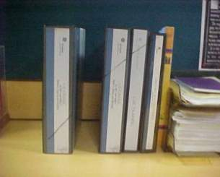
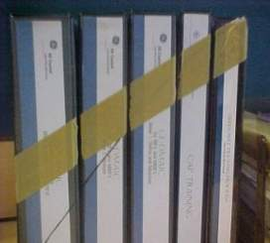
2S Example
5S Process
Before
Simple visual management system clearly shows what belongs and if something is missing
Visual management allows you to “manage by exception”
After
Picture reproduced with permission from GE Money

Slide 48
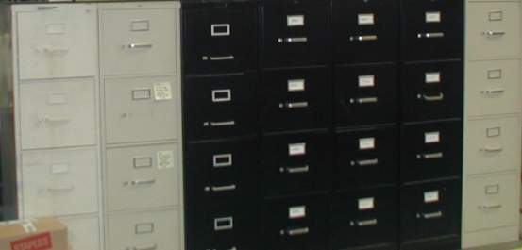
2S Example
5S Process
Moved these files to remote storage for mandatory retention period
Files were very rarely accessed (if ever)
Grouped by expiration date so that as new documents are moved into remote storage, expired data is discarded
Notes:
SAY: It is important to implement organizational techniques that keep you from creating “new unnecessary” items. This team implemented a process where they had to empty a slot before adding to it.

Slide 49
Exercise: 2S
5S Process
Objective
Complete 2S for the business event
Instructions
Time to Complete
As a team, discuss approach to completing 2S.
Assign individual tasks.
Determine time to accomplish 2S and review
results
Provided by instructor
Deliverable
Completed 2S
Notes:
DO: Work with teams to agree on time to complete 2S (and first S when needed). Instruct all teams to return to the training room at the specified time, regardless of whether or not they are actually done.

Slide 50
5S Process Steps
5S Process
1S - Sort
    2S - Straighten
3S - Scrub
4S - Stabilize
5S - Sustain

Slide 51
3S Defined
5S Process
English: SCRUB
Japanese: SEISO
Objective
of 3S
SCRUB
Cleaning floors, equipment, furniture in all areas of the workplace
SEISO
Cleanliness. Indicates the need to keep the workplace clean as well as neat. Cleaning in Japanese companies is a daily activity. At the end of each shift the work area is cleaned up and everything restored to its place.
Establish a clean workplace
3S identifies and eliminates the source of uncleanliness

Slide 52
Exercise: 3S
5S Process
Objective
Analyze Case study
Instructions
Time to Complete
In each team, carefully review the photos from the case study
Answer “how would you implement “3S” in this office?”
Discuss impact of first impressions on customers or visitors
Answer “what are the benefits to 3S?”
Record notes on chart paper for review with class
15 minutes
Deliverable
One person from each group reports results of discussion to rest of class
Notes:
NOTE: Potential Answers/Strategy:
Should polish all the furniture and use appropriate cleaners for the PC screen and keyboard. Make sure inside of drawers are cleaned, as well. Remove plastic flooring and clean well… vacuum carpet underneath before replacing. Use an antibacterial wipe to clean and sterilize phone. Consider adding a “wipe” dispenser for items requiring daily “cleaning” to make it quick and easy – the wipes can be used, discarded and you are done! Also, remember that if you did a good job with 1S, the number of items requiring maintenance and daily cleaning should be minimal!

Slide 53
3S Strategy
5S Process
Get out the cleaning supplies!
Look for root causes of uncleanliness
  Where does the “dirt” originate?
  Why do you have to clean at all?
  How can this “dirt” be prevented?
Review office furniture, lighting, equipment for repair
Eliminate any potential safety hazards (loose hardware, broken furniture, frayed electrical wiring, etc.)

Slide 54
3S Strategy, continued
5S Process
Allows you to quickly identify “defects”
Eliminates idea of “spring cleaning”
Maintains discipline
Becomes a part of your regular, daily routine
Dedicate FIRST five minutes of each day to systemic cleaning

Slide 55
Exercise: 3S
5S Process
Objective
Complete 3S for the business event
Instructions
Time to Complete
As a team, discuss approach to completing 3S.
Assign individual tasks.
Determine time to accomplish 3S and review
results
Provided by instructor
Deliverable
Completed 3S
Notes:
DO: Work with teams to agree on time to complete 3S (and second S when needed). Instruct all teams to return to the training room at the specified time, regardless of whether or not they are actually done.

Slide 56
5S Process Steps
5S Process
1S - Sort
    2S - Straighten
3S - Scrub
4S - Stabilize
5S - Sustain

Slide 57
4S Defined
5S Process
English: STABILIZE
Japanese: SEIKETSU
Objective
of 4S
STABILIZE
Maintaining and improving the standards of the first 3 S’s
SEIKETSU
Standards. Allows for control and consistency. Basic housekeeping standards apply everywhere in the facility. Everyone knows exactly what his or her responsibilities are. Housekeeping duties are part of regular work routines.
Maintain and improve the neat, organized workplace
4S not only maintains, but improves what has been put in place
Notes:
ASK: “Why is it important to stabilize?”
SAY: “Use 5S patrols or AUDITs to monitor 5S progress. What does not get measured does not get improved.”

Slide 58
4S Strategy
5S Process
Eliminate excess storage areas and flat surfaces where items can accumulate
Make changes to layout/furniture that make it easy to maintain order and cleanliness
Use a checklist to establish daily organization and cleaning activities (use recurring calendar to schedule reminders)
Perform self-assessments
Determine ways to prevent backsliding

Slide 59
4S Checklist Guidelines
5S Process
Post checklist in each area
Include “after” photos to show the standard
Ask co-workers to schedule surprise audits
Seek feedback and inputs often
Use checklist to record improvement opportunities and recommendations
Use the 5W1H process to determine root causes (5 Why’s and 1 How)
Implement corrective actions and improvements regularly

Slide 60
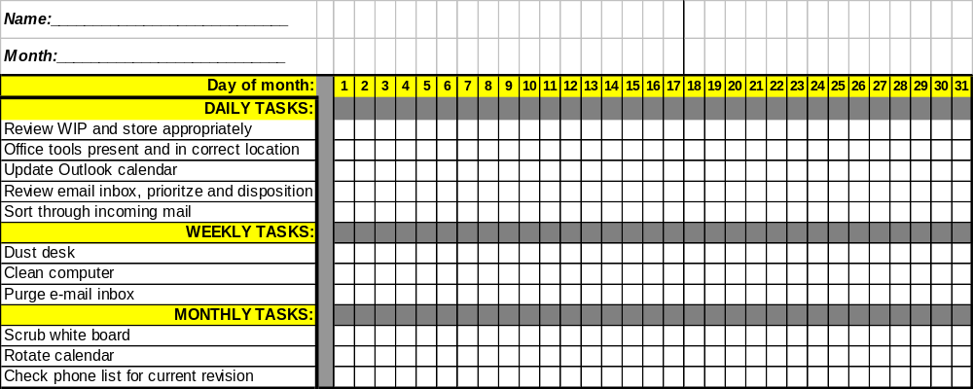
4S Checklist Example
5S Process
Establish daily, weekly and monthly tasks to maintain first 3S’s
Schedule tasks in calendar for reminders
Evaluate effectiveness of furniture and documentation methods
Customize to fit your business needs
Notes:
NOTE: This is a very simple example of a 4S checklist. Each area must customize or adapt this tool to fit their specific needs. Encourage owners to schedule these recurring tasks in Outlook or other calendar tool.

Slide 61
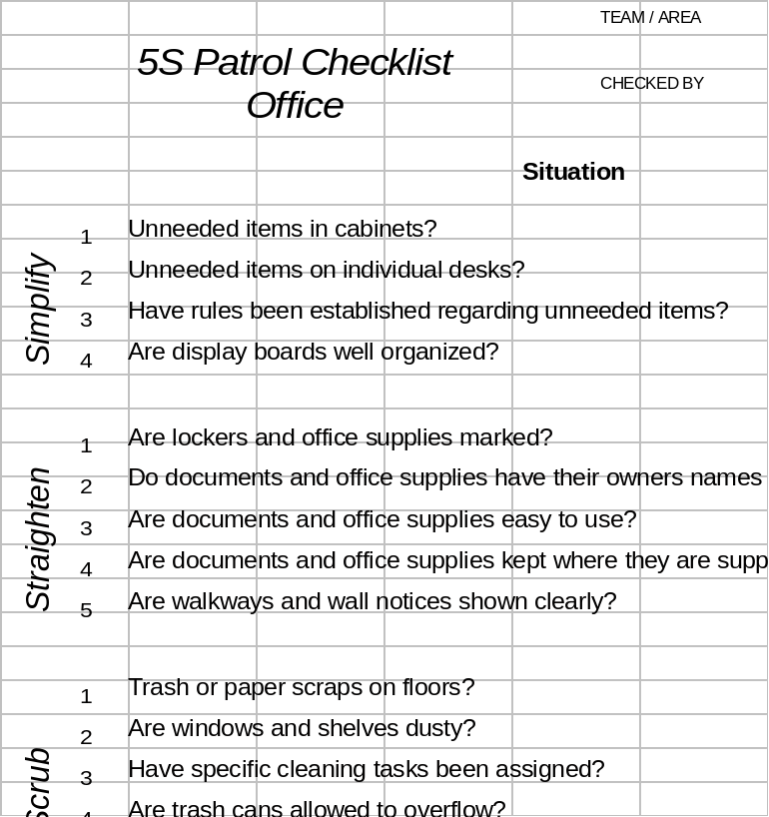
5S Assessment
5S Process
Develop a standard procedure for audits
Use form consistently to measure results of 5S in all areas
Include review of electronic/digital processes
Use for self-assessments and internal audits
Notes:
NOTE: The teams will be using this form to conduct the 5S audits at the end of this event. Hand out hard copies of this sheet from the Supplies worksheet, per the prep agenda.

Slide 62
Exercise: Identifying processes that need to be sustained
5S Process
Objective
Generate list of processes that need to be sustained
Instructions
Time to Complete
As a team, discuss which processes need to be
sustained from THIS event.
10 minutes
Deliverable
Generated list on chart paper
Notes:
SAY: Use this information sharing to add/jog other ideas to your list. Important to include key processes for sustainability now, to increase probability of success.

Slide 63
Exercise: 4S
5S Process
Objective
Complete plan for 4S for the business event
Instructions
Time to Complete
As a team, develop specific plan/process to
standardize and sustain the processes from the
generated list for this event
Assign owner(s)
Schedule daily/weekly/monthly/annual recurring tasks in owner’s calendar
Provided by instructor
Deliverable
Completed 4S plan
Notes:
DO: Work with teams to agree on time to complete 4S (and third S when needed). Instruct all teams to return to the training room at the specified time, regardless of whether or not they are actually done.

Slide 64
5S Process Steps
5S Process
1S - Sort
    2S - Straighten
3S - Scrub
4S - Stabilize
5S - Sustain

Slide 65
5S Defined
5S Process
English: SUSTAIN
Japanese: SHITSUKE
Objective
of 5S
SUSTAIN
Achieving the discipline or habit of properly maintaining the correct 5S procedures
SHITUSKE
Sustaining discipline. Refers to maintaining standards and keeping the facility in safe and efficient order day after day, year after year.
Develop a habit of sorting, straightening, scrubbing, and stabilizing your workplace
Everyone has to accept 5S as a personal goal
5S is about changing the discipline of your culture
Notes:
ASK: “A company president is walking through the office on his way to meeting, greets the associates with a friendly greeting as he passes them, and walks right by crumpled trash on the floor. What message does that send?”

Slide 66
5S Strategy
5S Process
Discipline yourself to maintain 5S procedures
Proliferate 5S across entire business
Hold each other accountable for sustainability
Set high standards for yourself and good example for others
Management must lead the way
Set the standard to benchmark
Include 5S in performance reviews
Notes:
SAY: “Achieving a 5S culture requires exquisite discipline. You must be responsible and hold each other accountable to sustain results and continue to improve.”

Slide 67
5S Rules of Discipline
5S Process
Keep it simple
Make it visual
Accept feedback and give it constructively
Correct problems immediately
Use 5W1H to address source of disorder or dirt
Energize yourself! Improvement requires effort and effort requires enthusiasm
Notes:
SAY: “Keep it simple, simple, simple…. Cannot stress this enough! And Make it visual, visual, visual! Use five-why’s and one how to address problems at root cause.”

Slide 68
Exercise: 5S
5S Process
Objective
Quantify benefits and perform audits of other teams’ areas.
Instructions
Time to Complete
As a team, review your list of wastes from 1S activity and quantify benefits of your event success (include estimated time savings, defect reduction, computer downtime, customer perceptions, pride and personal satisfaction).
Perform objective audit using the 5S Patrol Checklist of the other team’s areas, providing very specific feedback and ideas for improvement.
60 minutes
Deliverable
Measurable results obtained by event and thoughtful feedback for other teams
Notes:
NOTE: Make sure everyone has a copy of the “5S Patrol Checklist.” May need to change time to complete, based upon number of teams and location of each area.
NOTE: If there is only one team on for this event, have them audit their own results.

Slide 69
5S
5S Definition
5S Process
5S Review
Objectives:
Review 5S Process
Define relationship of 5S to lean business system
Identify common pitfalls when implementing 5S
Discuss how to avoid 5S common pitfalls
Review key learnings
Notes:
DO: Review section objectives on slide.

Slide 70
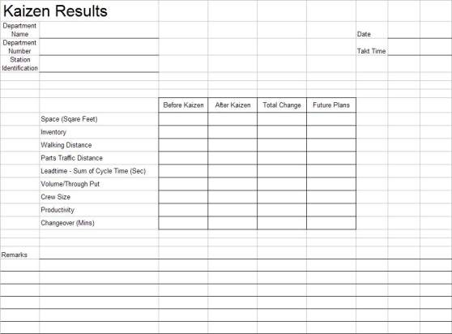
Kaizen Results
5S Review
Notes:
SAY: “Here is a form we recommend you use to track the kaizen results. This makes it easier to have a visual of the improvements made to date and the opportunities that still exist.”
NOTE: This form is in excel and additional measurements could be added per the event objectives.

Slide 71
Prepare for Final Report-Out to Management
5S Review
All team members should contribute to the final report-out presentation to management
Report-out should include
  Introduction of Team
  Review of Event goals and objectives
  Review of Former Process and Documentation Forms
  Review of Improvement Opportunities Identified and Implemented
  Review of Documentation and Kaizen Results Form
  Review of Kaizen Newspaper
Typical Report-Out times are 15 minutes for presentation and 15 minutes for questions
Notes:
DO: Cover report-out guidelines.

Slide 72
Summary of 5S
5S Review
5S Descriptions
1S
Sort
Define what is necessary and unnecessary
2S
Straighten
A place for everything and everything in its place
3S
Scrub
Identify the sources of uncleanliness
4S
Stabilize
Execute process to maintain/improve the standards of the first 3 S’s
5S
Sustain
A sustained, disciplined 5S culture in the workplace
Notes:
DO: Ask participants to reiterate the 5S’s.

Slide 73
5S is Key to a Lean Business System
5S Review
Develop Strategic
Business Imperatives
Profitable Growth
Enterprise Optimization
5S
Value Stream Optimization
5S
Lean Fundamentals
Waste Elimination Tools
5S
Lean Infrastructure
Notes:
SAY: “A Lean Business System represents the methodology and approach used to Implement and Deploy Lean into an Organization.”
SAY: “LEAN” is simply the elimination of waste. 5S is a MUST. It is related to every improvement process you will embark upon. As you have seen this week, LACK of 5S CREATES waste, and implementation of 5S “reveals” the true process, enabling further improvement. 5S is a foundational tool in a lean organization. It creates the discipline needed to improve and sustain results.
NOTE: The Strategic Business Imperatives guide all lean efforts and activities which is why this is shown at the top. We then work our way up to fulfilling our strategy by deploying lean in this sequence.

Slide 74
Common pitfalls to sustaining 5S
5S Review
Lack of assessment procedures
Perception is that 5S is about “cleaning”
Perception that this is a 1-time event… not a continuous process
5S not seen as a management tool
5S viewed as somebody else’s responsibility
5S viewed as “simple” and that everyone “knows how to do it”
Notes:
ASK: What other barriers do you foresee? Or have you seen? (Write them down)
ASK: What are specific barriers you see to sustaining 5S in our electronic/virtual world? (Write them down)

Slide 75
Exercise: How to avoid common pitfalls
5S Review
Objective
Discuss methods to avoid the common 5S pitfalls
Instructions
Time to Complete
In small groups, list all areas in your personal life where you excel at 5S (car, boat, home, teeth, garage, etc.) and how you overcome barriers to sustaining these areas of your life.
Apply these same concepts to this event and determine what actions could be taken or what
must be done to overcome barriers at work
Chart ideas on chart paper.
20 minutes
Deliverable
Report-out on ideas for avoiding pitfalls
Notes:
NOTE: Have participants break out into different groups (other than their original 5S “team”)

Slide 76
Summary of 5S
5S Review
5S is a foundation for improvement
Visual management is the ultimate goal
It is up to each and every one of us to make 5S a personal goal
Notes:
DO: Summarize the importance of 5S and ask participants to describe what they can do right now (when they return to their workplace) to begin to implement a 5S program.

Slide 77
Exercise: 5S Event Wrap-Up
5S Review
Objective
Document event results and record lessons learned.
Instructions
Time to Complete
Each team photograph all “after” areas
Post 4S Checklist and 5S Audit Sheet in area
Record top 3-5 lessons learned on chart paper
Celebrate!
60 minutes
Deliverable
Invite others for report-out of results and a tour of “new” areas

Slide 78
Other Modules In This Series:
5S
Standard Work
Total Productive Maintenance (TPM)
Administrative Lean
Cell Design/ Production Preparation Process (3P)
Kaizen
Kanban
Problem Solving
Poka Yoke Quality Systems
Transaction Process Improvement (TPI)
Cause & Effect Diagram with the Additions of Cards (CEDAC)
Single Minute Exchange of Dies (SMED)
Value Stream Mapping (VSMi®)
Visual Management
Managing Daily Process Excellence
For More Information Please Contact:
Mark DeLuzio, President and CEO
+1.860.234.0915
mark.deluzio@leanhorizons.com
Strategically Creating Value Through the Elimination of Waste

Slide 79
APPENDIX: Visual Management
Standard Color Guide
 | Safety International Green | Safety Equipment, First Aid, Safety Posters, Notices
 | Quality International Blue | Inspection Points, Quality Notices and Instructions, Gauging
 | Standards Federal Safety Yellow | Operations Standards, Location Marks, New Tooling, Good Part Storage
 | Defects Federal Safety Red | Scrap, Bad Parts, Warranty Materials, Dull Tools
 | Maintenance Pure White | Repair Tools, TPM Materials, Machinery, Cleanliness
Notes:
SAY: “Identify critical items, parts, and areas within factories with common colors which provides for a common understanding for any associate or visitor.”

